Slide 1
Solid Wastes
Student’s Name
Institutional Affiliation

Slide 2
Introduction
Solid waste management is an important task that everyone should engage with more carefully.
Maintaining a clean and healthy environment requires everyone’s input in enhancing its general health and safety.
Solid wastes can be detrimental to environmental health and safety which is why risk assessment is needed.

Slide 3
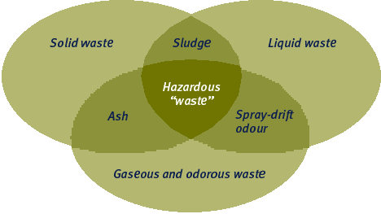
Cont’

Slide 4
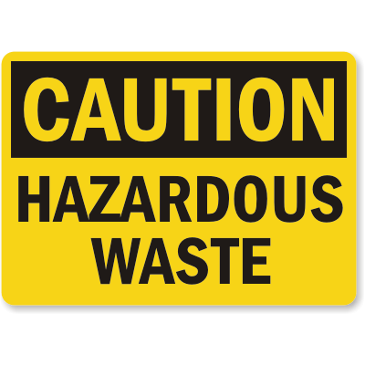
Attributes of Solid and Hazardous Waste
Ignitability
Corrosivity
Reactivity
Toxicity

Slide 5
Resource Conservation and Recovery Act (RCRA) definitions
Solid waste
RCRA defines a solid waste as any form of refuse or garbage, water treatment supply treatment plant, wastewater “treatment plant, or air pollution control facility and other discarded material, resulting from industrial, commercial, mining, and agricultural operations, and from community activities. Nearly everything we do leaves behind some kind of waste” (EPA, 2020 para. 3).

Slide 6
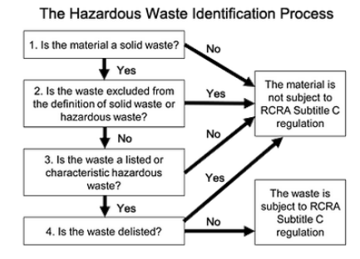
Cont’
Hazardous waste
Hazardous wastes are ones that cause health hazards to humans and the environment. Nevertheless, it is difficult to determine whether a substance is a hazardous waste or not. Therefore, this picture helps identify some of the steps used to determine hazardous wastes.
(Nickovich, 2004)

Slide 7
The role of risk assessment
This is a technique used in risk management. It is a process used by government and scientists to measure the extent of health complications in the people exposed to toxic substances.
The risk estimates can be used by the government to set up regulatory standards aimed at minimizing people’s exposure to toxic substances that would risk their health.
  (Gwinn et al., 2017)

Slide 8
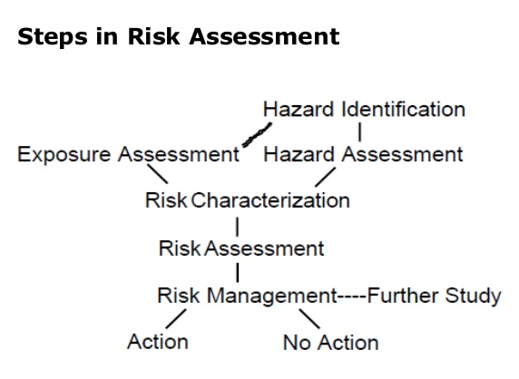
Cont’

Slide 9
Cont’
Hazard identification
The primary hazards for humans include organic chemicals, pathogens and their toxins, heavy metals, and mechanical hazards.
Hazard Assessment
Aspergillus fumigatus poses a major threat to human health as they result in Aspergillosis also known as brown lung disease.
Aspergillus fumigatus grows in decaying vegetable matter and is produced in composite manure, silage and wastewater sludge composite.
(Durmusoglu, Taspinar & Karademir, 2010)

Slide 10
Cont’
Exposure Assessment
Exposure refers to the frequency and intensity and duration of agent exposure on a subject.
Exposure can involve inhaling dust or ingesting soil or composite (children) or through food.
Suspicion to exposure is only monitored by studying the patterns of the media (soil, air, food, water) and affected people they come in contact with.
(Rosner & Markowitz, 2017)

Slide 11
Cont’
Risk assessment
A risk assessment of SW can take place following an understanding of hazard distribution and their outcomes.
Strategies for Risk Assessment
Most Exposed Individual (MEI)
  This approach estimates how different populations are exposed
Alternative Pollutant Limits (APL)
This approach uses real situations and data to determine exposure patterns and their extent of risk.

Slide 12
Cont’
C. Uncertainty Analysis
This approach applies simulation technology and data to determine the frequency of exceeding risk values.

Slide 13
Risk Management
The purpose of risk assessment is helping in the management of risks. It assists the regulating bodies, makers of policy, and the managers to select the most appropriate actions when needed.

Slide 14
Interplay of industry interests versus regulatory protections
Environmental regulation has drawn many fears among policy makers that most industries would be drawn out of the States.
However, this is not true as industries play an important role in safeguarding the environment and promoting environmental safety and health.
Environmental regulation plays no role in deciding the location of an industry.
(Stafford, 2000)

Slide 15
Cont’
Environmental regulation affects the cost of providing hazardous waste management services.
Much as environmental regulation may not affect the location of firms within the industry, there is a likelihood that they may affect the location of firms in other industries.

Slide 16
Conclusion
Humans are creators not destroyers of the environment. We are innovators but not polluters. We use resources, we don’t abuse them. we can manage and use solids but not waste them.

Slide 17
References
EPA. (2020, May 21). Criteria for the definition of solid waste and solid and hazardous waste exclusions. US EPA. https://www.epa.gov/hw/criteria-definition-solid-waste-and-solid-and-hazardous-waste-exclusions
Gwinn, M. R., Axelrad, D. A., Bahadori, T., Bussard, D., Cascio, W. E., Deener, K., … Burke, T. A. (2017). Chemical risk assessment: Traditional vs public health perspectives. The American Journal of Public Health, 107(7), 1032–1039. Retrieved from https://libraryresources.columbiasouthern.edu/login?url=http://search.ebscohost.com/login.aspx?direc t=true&db=bsu&AN=123619540&site=ehost-live&scope=site
Rosner, D., & Markowitz, G. (2017). "Ain't necessarily so!": The brake industry's impact on asbestos regulation in the 1970s. American Journal of Public Health, 107(9), 1395–1399. Retrieved from https://libraryresources.columbiasouthern.edu/login?url=http://search.ebscohost.com/login.aspx?direc t=true&db=bsu&AN=124558316&site=ehost-live&scope=site
Stafford, S. L. (2000). The impact of environmental regulations on the location of firms in the hazardous waste management industry. Land Economics, 569-589.
Nickovich, J. (2004). EPA Broadens RCRA Definition of" Hazardous Waste" to Include Mixtures and Derivatives. Ecology Law Quarterly, 31(3), 781-785.
Durmusoglu, E., Taspinar, F., & Karademir, A. (2010). Health risk assessment of BTEX emissions in the landfill environment. Journal of hazardous materials, 176(1-3), 870-877.

